Slide 1

DISCRETE MATHEMATICS
Chapter 5:
BOOLEAN ALGEBRA
Presenter: Ph.D. Phu-Nguyen Le
June 7th, 2023
1

Slide 2
Introduction
5.1. DEFINITION.
5.1.1 Definition of Boolean algebra.
5.1.2. Properties.
5.2. BOOLEAN FUNCTION.
5.2.1. Definition
5.2.2. Performance.
5.2.3. Logic gates
2

Slide 3

5.1 DEFINITION
5.1.1 Definition of Boolean algebra
In Boolean algebra, a variable is a symbol used to represent an action, a condition, or data. A single variable can only have a value of 1 or 0.
The complement represents the inverse of a variable and is indicated with an overbar. Thus, the complement of A is $\overline{A}$.
The complement represents the inverse of a variable and is indicated with an overbar. Thus, the complement of A is A.
3

Slide 4

5.1 DEFINITION
5.1.1 Definition of Boolean algebra
Addition is equivalent to the OR operation. The sum term is 1 if one or more if the literals are 1. The sum term is zero only if each literal is 0
Determine the values of A, B, and C that make the sum term of the expression $\overline{A}$ + B + C = 0?
4

Slide 5
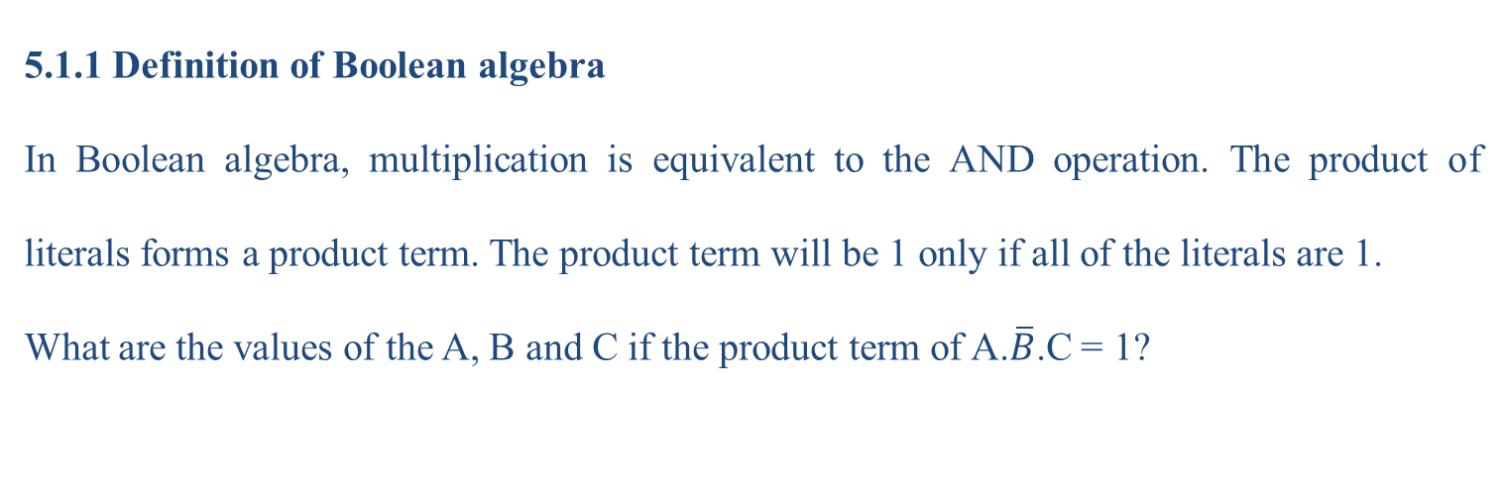
5.1 DEFINITION
5.1.1 Definition of Boolean algebra
In Boolean algebra, multiplication is equivalent to the AND operation. The product of literals forms a product term. The product term will be 1 only if all of the literals are 1.
What are the values of the A, B and C if the product term of A.$\overline{B}$.C = 1?
5

Slide 6
5.1.2 PROPERTIES
Commutative Laws
The commutative laws are applied to addition and multiplication.
For addition, the commutative law states
In terms of the result, the order in which variables are ORed makes no difference.
A+B=B+A
For multiplication, the commutative law states
In terms of the result, the order in which variables are ANDed makes no difference.
A+B=B+A
6

Slide 7
5.1.2 PROPERTIES
Associate Laws
The associative laws are also applied to addition and multiplication.
For addition, the associative law states.
When ORing more than two variables, the result is the same regardless of the grouping of the variables.
(A+B)+C=A+(B+C)
For multiplication, the associative law states
When ANDing more than two variables, the result is the same regardless of the grouping of the variables.
A+B=B+A
7

Slide 8
5.1.2 PROPERTIES
Distributive Law
The distributive law is the factoring law. A common variable can be factored from an expression just as in ordinary algebra. That is
(A+B)C=AC+BC
8

Slide 9
5.2 BOOLEAN FUNCTION
5.2.1 Definition
Given a set B={0,1}, and a function f=f(x₁,x₂,…,x_{n}) that has value of B. Boolean function of n variable is defined:
f= B^{n} ->B, for B={0,1}
9

Slide 10

5.2 BOOLEAN FUNCTION
5.2.2 Performance
Rules of Boolean Algebra
    1. A+0=A 6. A+$\overline{A}$=1
    2. A+1=1
    3. A.0=0
    4. A.1=A
    5. A+A=A
9

Slide 11

5.2 BOOLEAN FUNCTION
Rules of Boolean Algebra
    A.A=A
    A. $\overline{A}$=0
    A=$\overset{̿}{A}$
    A + AB = A
    A + $\overline{A}$B = A + B
    (A + B)(A + C) = A + BC
10

Slide 12
5.2 BOOLEAN FUNCTION
Illustrate the rules
11

Slide 13

5.2 BOOLEAN FUNCTION
De Morgan’s 1st Theorem
The complement of a product of variables is equal to the sum of the complemented variables
$\overline{A}$ $+\overline{B}=\overline{AB}$
12

Slide 14

5.2 BOOLEAN FUNCTION
De Morgan’s 2nd Theorem
The complement of a sum of variables is equal to the product of the complemented variables.
$\overline{A}$ $.\overline{B}=\overline{A+B}$
12

Slide 15
5.2 BOOLEAN FUNCTION
De Morgan’s 2nd Theorem
The complement of a sum of variables is equal to the product of the complemented variables.
$\overline{A}$ $.\overline{B}=\overline{A+B}$
14

Slide 16
5.2 BOOLEAN FUNCTION
SOP and POS
Boolean expressions can be written in the sum-of-products form (SOP) or in the product-of-sums form (POS). These forms can simplify the implementation of combinational logic, particularly with PLDs. In both forms, an overbar cannot extend over more than one variable.
An expression is in SOP form when two or more product terms are summed as in the following examples:
A B C + A B A B C + C D C D + E
16

Slide 17
5.2 BOOLEAN FUNCTION
SOP and POS
An expression is in POS form when two or more sum terms are multiplied as in the following examples:
(A + B)(A + C) (A + B + C)(B + D) (A + B)C
17

Slide 18
5.2 BOOLEAN FUNCTION
SOP and POS
An expression is in POS form when two or more sum terms are multiplied as in the following examples:
(A + B)(A + C) (A + B + C)(B + D) (A + B)C
18

Slide 19
5.2 BOOLEAN FUNCTION
SOP and POS standard form
In SOP standard form, every variable in the domain must appear in each term. You can expand a nonstandard term to standard form by multiplying the term by a term consisting of the sum of the missing variable and its complement
In POS standard form, every variable in the domain must appear in each sum term of the expression. You can expand a nonstandard POS expression to standard form by adding the product of the missing variable and its complement and applying rule 12,
19

Slide 20
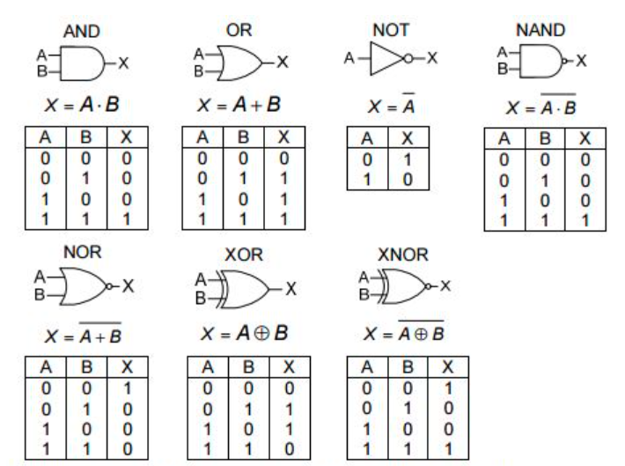
5.2 BOOLEAN FUNCTION
5.2.3 Logic gates
19

Slide 21
THANK YOU!

